Slide 1
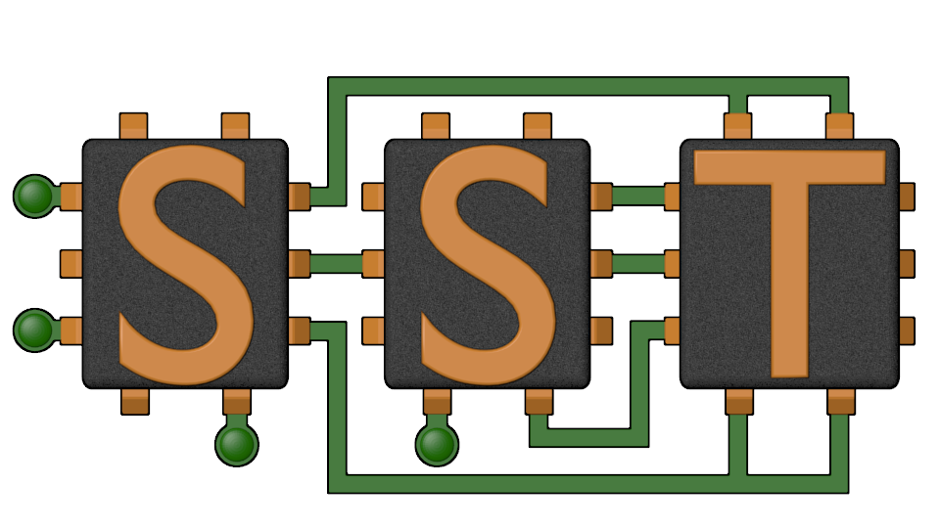
P38 Scatter Gather Experiments
The SST Team
SAND2020-12393 TR

Slide 2
Agenda
1000-1005 LPS/P38 Introduction
1005-1100 SST Overview & Configuration
1100-1200 Developing with SST
1200-1215 Break
1215-1245 P38 Scatter/Gather Experiments
1245-1330 Memory hierarchy (Gwen/Scott?)
1330-1345 Break
1345-1415 Broader SST Community (LLNL, GPGPUSim, GeM5)
1415-1445 Open Discussion

Slide 3
P38 Background
Initial Discussions (Sept 2017)
Brainstorm Architecture Ideas (e.g. “S/G”)
Summer 2018
Explore small set of architectures
Define applications scope
Late 2018-2019
Application Analysis
Refine Architectural ideas
Exploring software
Exploration Goals
Is there a “win” here?
Upside potential
Simulation Goals
Evaluate Implementation options
Foundation for future collaboration
Notes:
QUICK
Cultural & organizational constraint space
As well as how we organize research efforts

Slide 4
Application Analysis Infrastructure

Slide 5
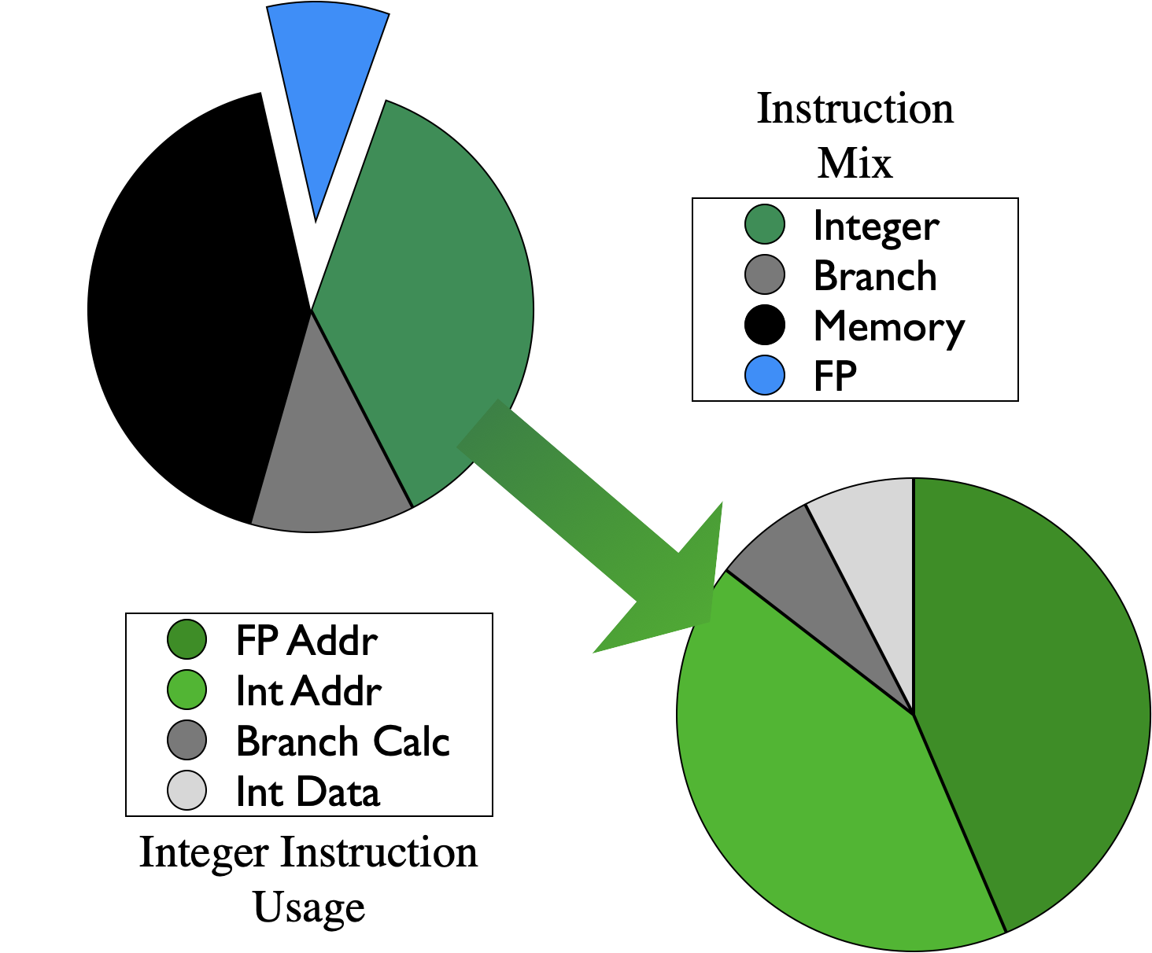
Simple Analysis: Instruction Mix
Dynamic Instruction Mix
~40-50% Memory
~20-40% Integer
~15-40% Other (Branch, FP, etc…)
Most Integer instructions calculating memory addresses

Slide 6
Application Analysis Goals
Find Applications of interest
Potential “wins”, but still realistic
Understand what access patterns look like
Develop techniques to identify likely offload / scatter-gather sections

Slide 7
Key Components
Ariel Processor Model
MemHierarchy
Caches
Dir. Controller
Mem Controller
Merlin Network Model

Slide 8
Key Components
Ariel Processor Model
MemHierarchy
Cache
Dir. Controller
Mem Controller
Merlin Network Model

Slide 9
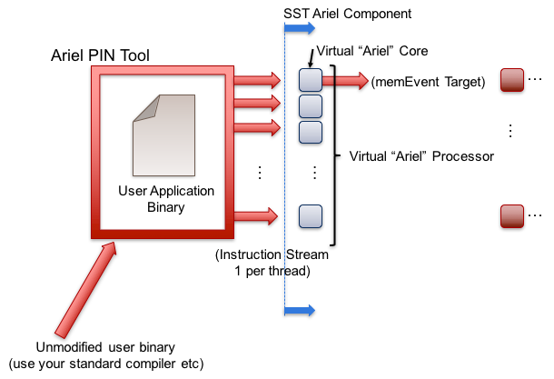
Ariel: PIN-based processor
Lightweight processor core model
Uses Intel’s PIN (dynamic binary instrumentation)
Passes instructions to virtual core in SST via shared memory
Ariel’s virtual cores
Memory instruction oriented: execute memory instructions; other ins. single cycle
Does not maintain dependence order or register locations
Key parameters
Ops issued/cycle
Load/store queue size
Processor
Memory
Network/NoC
Network driver
Other

Slide 10
Ariel: The Tradeoff
Pros:
Faster than more complex/pipeline models
Software: easy to target, malleable
Reasonable approximation for studies on memory system performance
Especially for heavily memory-bound applications
Reasonable model of thread interactions
Cons
Non-deterministic results
Interactions between pintool, threads, etc.
Variation is low (O(1%))
Not compatible with non-x86 binaries
Reliant on Pin
Less accurate for heavily compute-bound
Processor
Memory
Network/NoC
Network driver
Other

Slide 11

MemHierarchy: Memory system
More This Afternoon
Collection of interoperable memory system elements ($s, directories, scratchpad, etc…)
Components are cycle-accurate/cycle-level
Cache Model
Arbitrary hierarchy depth, flexible topologies
Cache inclusivity, coherence, private/shared, etc. configurable
Single- and multi-socket configurations
Memory Controller backends:
Simple Timing Model
Basic DRAM timing (sense amp delay)
Wrappers for an external/non-native-SST simulators
Ramulator, DRAMSim2, etc.
Memory
Processor
Network/NoC
Network driver
Other

Slide 12
Merlin Network simulator
More This Afternoon
Low-level networking components that can be used to simulate high-speed networks (machine level) or on-chip networks
Capabilities – Merlin
High radix router model (hr_router)
Topology: Crossbar
Network
4 processor clusters
4 cores/cluster
4 L1s 4 (optional) scratchpads
1 L2 $
Memory Controller (DRAMSim2)
Network/NoC
Processor
Memory
Network driver
Other

Slide 13
Analysis Infrastructure
CacheLineTrack
Subcomponent
“Cache Listener”
Built on interface for prefetchers: notified of reads, writes, evictions
Gathers post-cache histograms, cache use stats, etc…
accPat “Access Pattern Tracker”
Added to a memory controller model
Tracks access patterns by “page”
Allows….
…/elements/cassini/cacheLineTrack.*
…/elements/memHierarchy/membackend/pagedMultiBackend.*

Slide 14
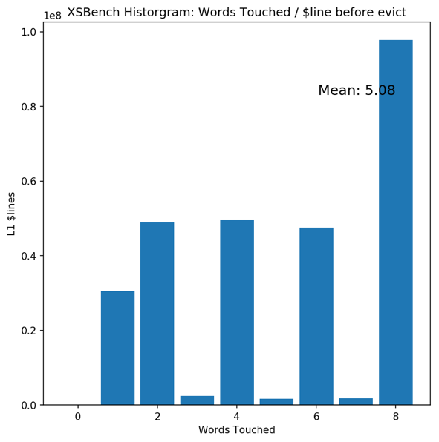
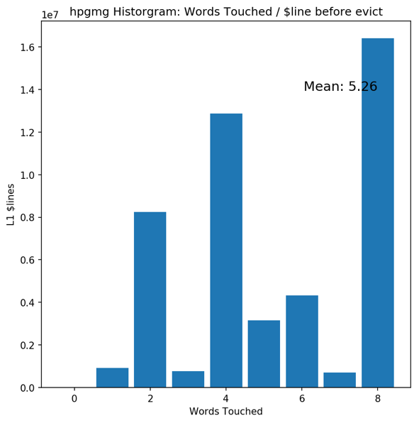
Words Touched Before $ Evict
🙂
🙂
a
Better understanding of where caches aren’t working
Notes:
Smily in the sense that there is room for the improvement – it could be a frown in the sense that we are very wasteful

Slide 15
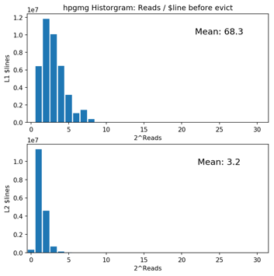
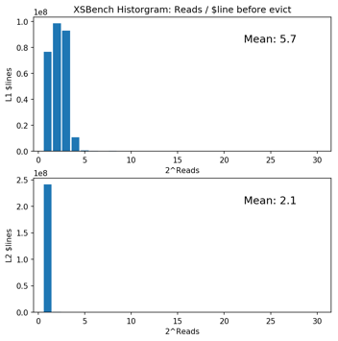
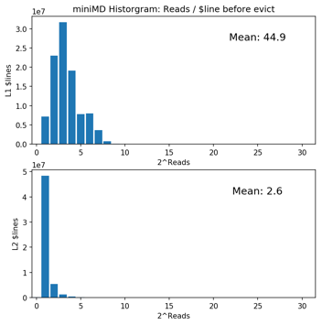
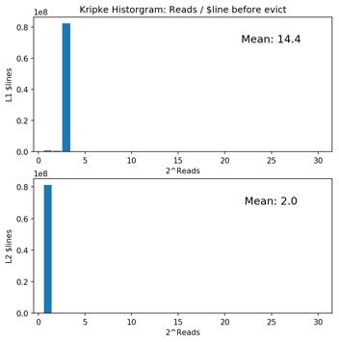
Reads Before Evict
L1s: Lots of variation
6 (XSBench) to 68 (hpgmg) reads before eviction
Most $lines <16
L2s
Much less (2-3) reads before evict
Writes broadly similar
Useful for identifying scratchpad candidates

Slide 16
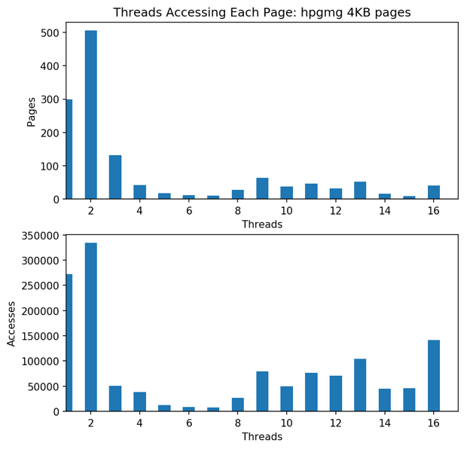
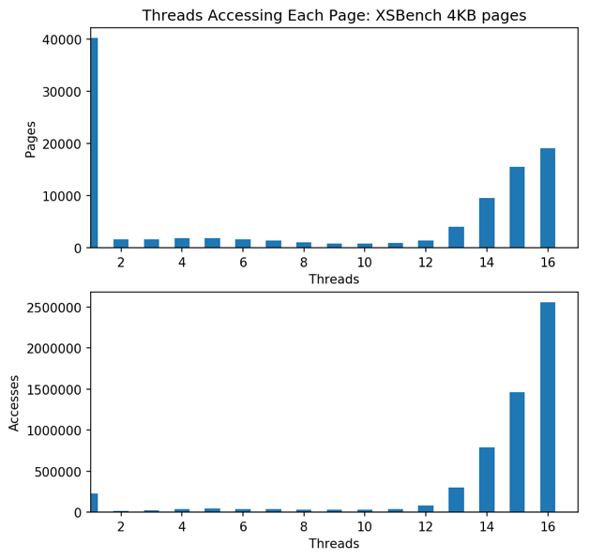
Threads/Page Access
a
🙂
🙁
Will thread sharing complicate implementation?
😐
☹️

Slide 17
Usage Histograms
In most applications, small number of pages account for disproportionate number of accesses
Small cache can capture a lot
Diminishing returns as $ gets larger
Useful for Scratchpad sizing

Slide 18
Access Pattern Detection
First quick cut of access pattern detection
Examines post-cache misses
Determines simple pattern (5 classes)
Cluster Centers
How complex are access patterns?

Slide 19
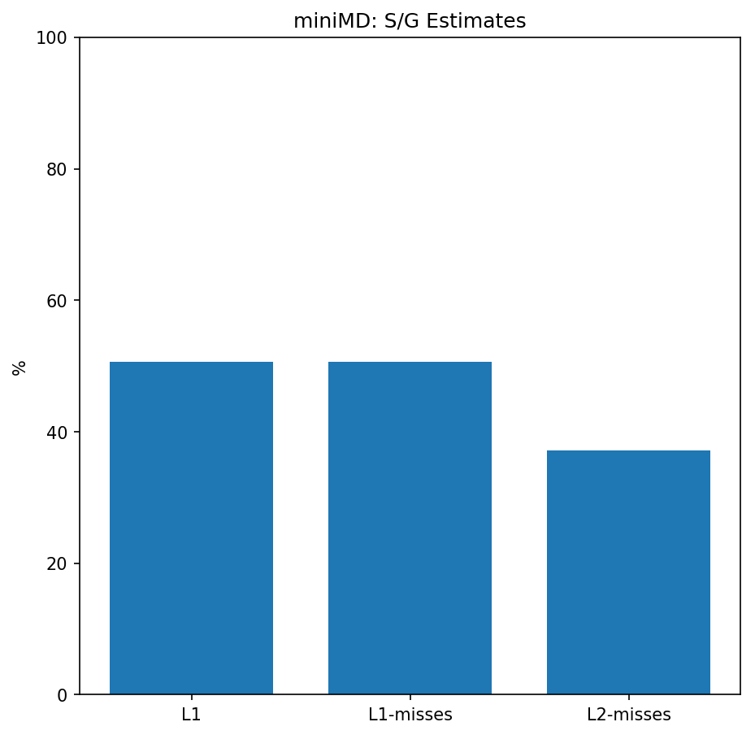
MiniMD: Memory Hotspots
miniMD/kokkos/force_lj.cpp:
void ForceLJ::operator():
const MMD_float xtmp = x(i,0);
const MMD_float ytmp = x(i,1);
const MMD_float ztmp = x(i,2);
for(int k = 0; k < numneighs; k++) {
const MMD_int j = neighbors(i,k);
const MMD_float delx = xtmp - x(j,0);
const MMD_float dely = ytmp - x(j,1);
const MMD_float delz = ztmp - x(j,2);
const int type_j = type[j];
}
f_a(i,0) += fix;
f_a(i,1) += fiy;
f_a(i,2) += fiz;
Which regions should be targeted?
3 sites in one file
Good capture
May require atomics (FP+)

Slide 20
Scatter/Gather Evaluation

Slide 21
S/G Evaluation Goals
Identify regions of selected applications that may be amenable to near-memory “scatter-gather”
Estimate total application performance improvement

Slide 22
Evaluation Infrastructure
Added Scratchpad
Added Prefetch logic to Ariel
Emulates near-memory accesses
S/G mem ops queue’d up (Prefetch Queue)
Consolidates scatter-gather accesses
Adds latency, throttles issue width
Sends to memory
Loads to $ or scratchpad

Slide 23
Evaluation Infrastructure: Application
Modified applications based on analysis
“Tag” S/G sections
Send tagged/ annotated stream back to Ariel
Track & gather statistics

Slide 24
Evaluation Infrastructure: Application Interface
…/elements/ariel/frontend/simple/ fesimple.cc
Normal Ariel just passes reads/writes and other instructions back to Ariel CPU
Modifications for P38
Add “buoy” functions which PIN replaces with markers
Toggling to indicate non-memory instructions (i.e. would be offloaded)
Prefetch loads (coalesced, sent directly to memory)
Optionally, return to scratchpad
…/elements/ariel/arielcore.cc
https://github.com/afrodri/sst-elements/tree/afrodri/sgEst

Slide 25
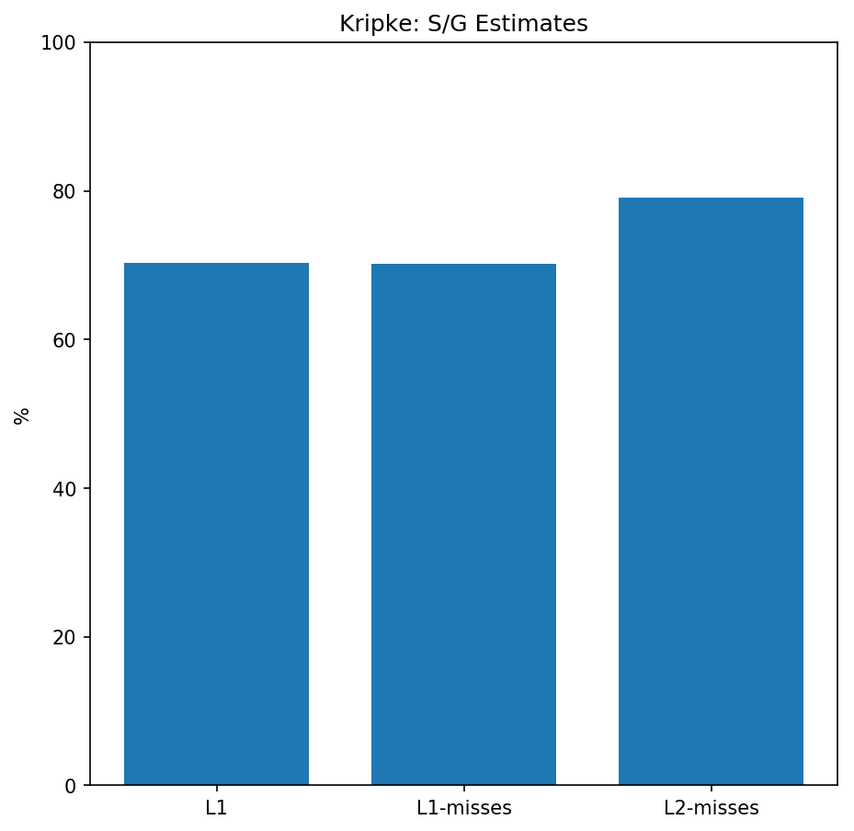
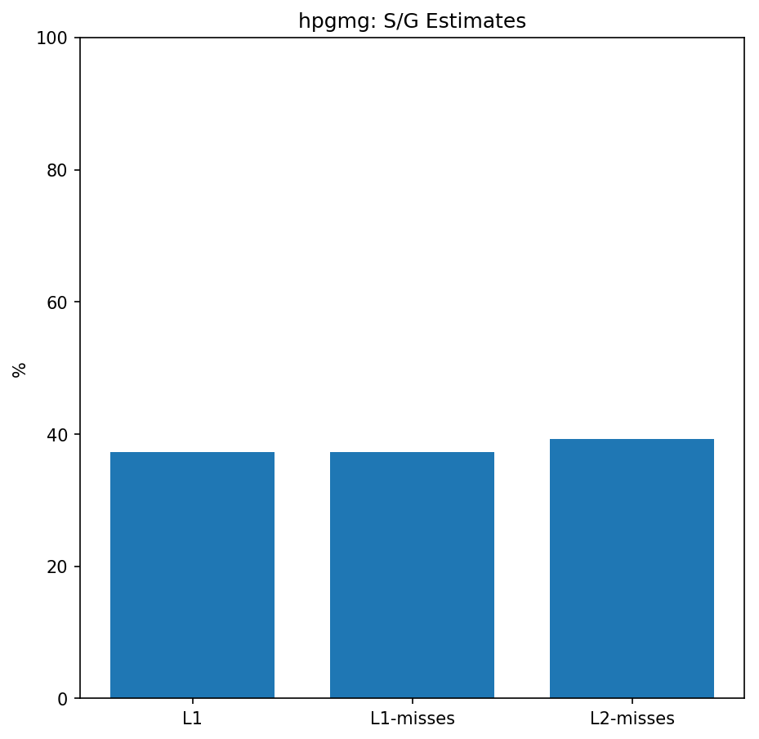
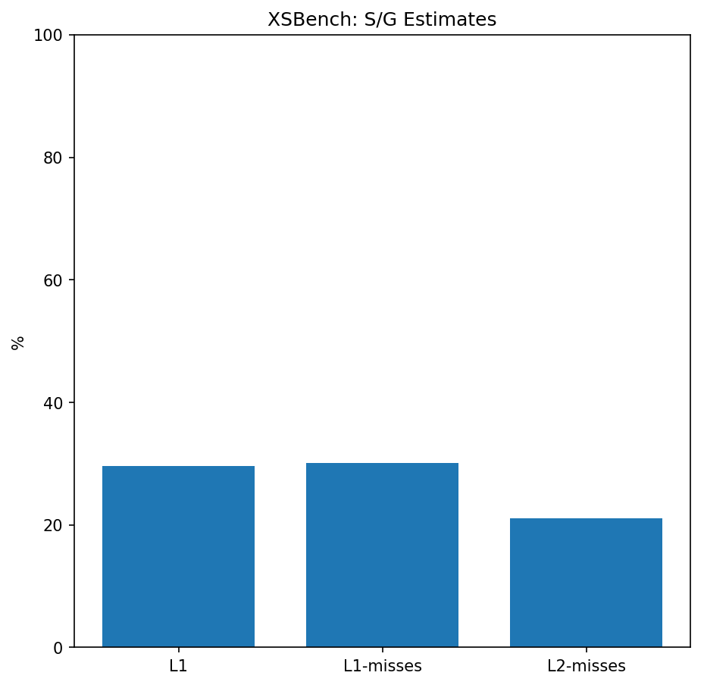
Initial Applications: Kripke, hpgmg, XSBench
Applications modified
Difficult! High bar:
Kripke: 98% L1 hit, high L2, multiple “hot” s/g regions, ~70% accesses in s/g, thread local
hpgmg: 98-99% L1 hit 😰
XSBench: upto 5% L1 miss, 30% s/g, complex s/g region
If we can show improvement here, we can probably improve many apps
🙂
😰
😰
😰

Slide 26
Evaluation Infrastructure: Application Modifications
“Prefetch Loop”
Toggle so non-memory not counted
int scOff = 1;
for(int gz = 0;gz < num_locgz; ++ gz){
ariel_toggle();
ariel_pf(&psi_d[gz], scOff++);
ariel_pf(&phi_nm[gz], scOff++);
ariel_toggle();
}
for(int gz = 0;gz < num_locgz; ++ gz){
phi_nm[gz] += ell_nm_d * psi_d[gz];
}
Issue Prefetch (opt: To scratchpad)
PFs are coalesced to improve density
PFs to scratch have addresses remapped
Original Loop
Allows…

Slide 27
Performance estimates
Effect 1: Reduce $ Misses
Many L1 misses become hits
13-40% IPC improvement
Effect 2: Integer offload
17-44% IPC Improvement
Effect 3: Improved $ performance
If covered cache accesses go to scatchpad, other accesses more efficient?

Slide 28
S/G to Scratchpad
Identify regions to S/G to scratchpad, offload
Demonstrate:
Able to offload substantial % of integer operations
Good reuse of data when in scratchpad
Scratchpad sizes reasonable (L1 sized)
S/G data less “dense” – can be smarter / more efficient than Cache
🙂
🙂
😐
🙂
(☹️)

Slide 29
Summary
SST provided
Analysis infrastructure
S/G Evaluation infrastructure
Quick development
No need to modify compiler
Wide range of access patterns identified
Useful basis of collaboration?

Slide 30
Questions?

